Slide 1
COMS E6998: Microservices and Cloud Applications Lecture 2: Microservice and Cloud Application Basics
Dr. Donald F. Ferguson
dff9@columbia.edu

Slide 2
Contents

Slide 3
Contents
Introduction: Questions? Comments? Discussion?
(Web) Application Basics
Structure.
Application design methodologies.
Model-View-Controller.
Let’s Design an Application
Data Model.
User Interface.
Microservice Model.
REST and Resource Model.
1st Assignment.

Slide 4
Introduction Questions? Comments? Discussion?

Slide 5
(Web) Application Basics

Slide 6
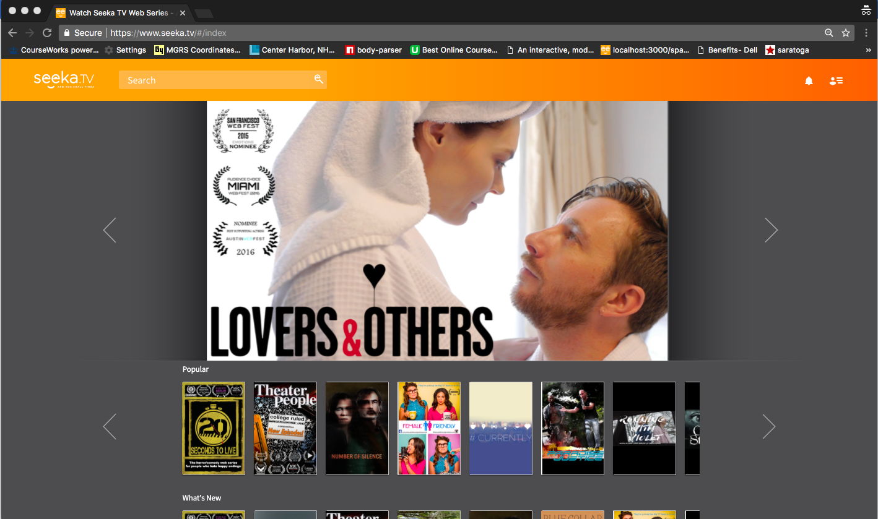
Seeka TV Demo

Slide 7
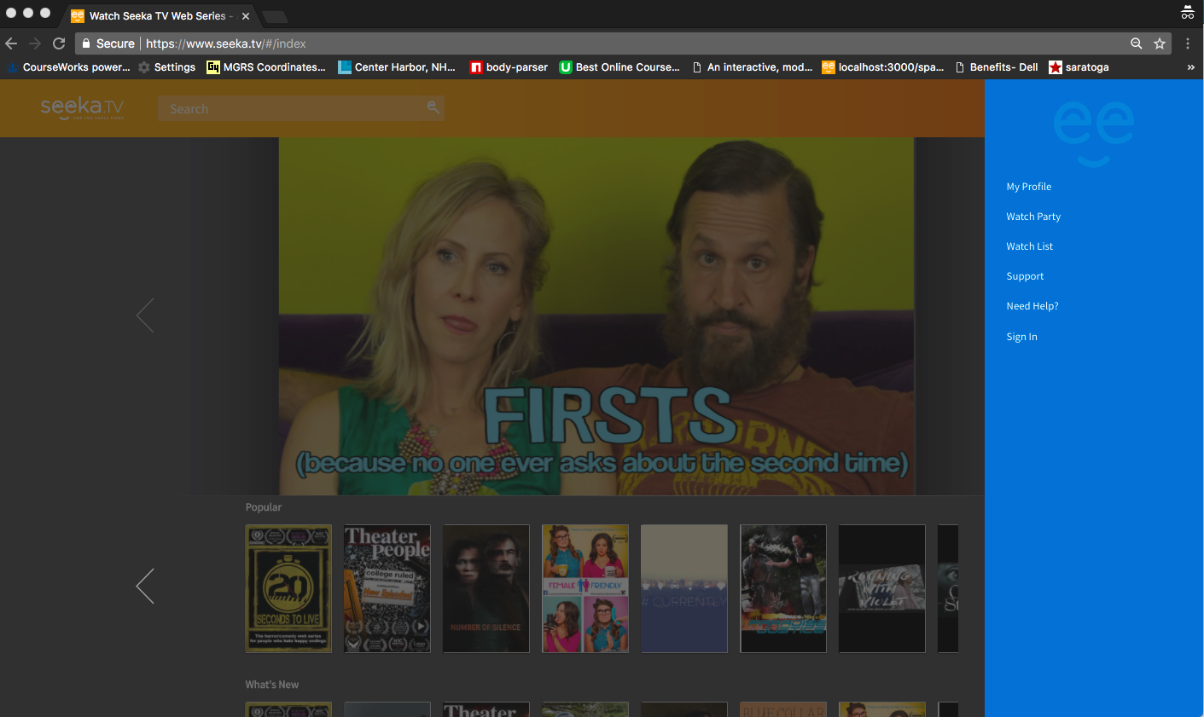
Seeka TV Demo

Slide 8
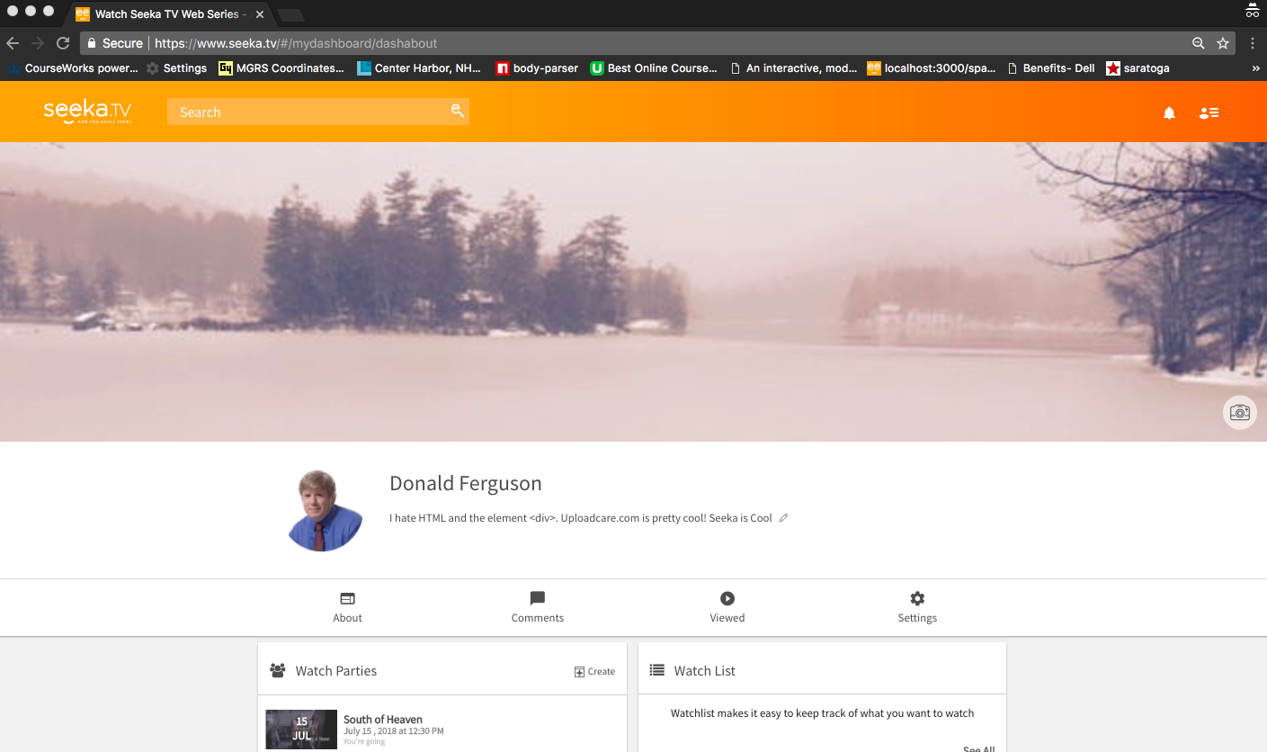
Seeka TV Demo

Slide 9
Web Application Basic Concepts

Slide 10
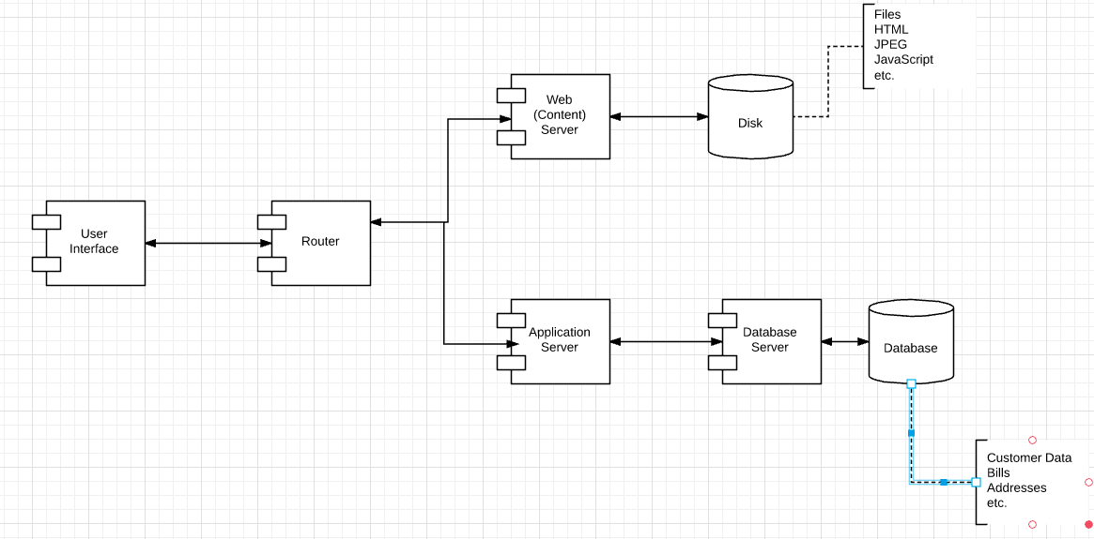
A “Little More” Detail

Slide 11
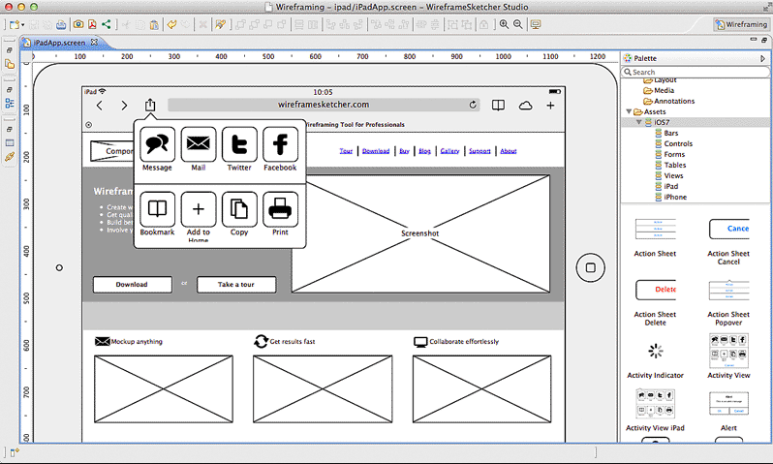
(Some) Application Design Methodologies
Start with User Interface
Roles and personas.
Wireframes for pages and interactions.
Page flow/transition diagrams.
Implement a model layer supporting UI
Functions
Data
Start with Data Model
Entity types, properties.
Relationships/associations.
Constraints, integrity rules
Define reusable core operations.
Design role/task UIs that use core operations

Slide 12
Start with User Interface
Roles and personas.
Wireframes for pages and interactions.
Page flow/transition diagrams.
Implement a model layer supporting UI
Functions
Data
Start with Data Model
Entity types, properties.
Relationships/associations.
Constraints, integrity rules
Define reusable core operations.
Design role/task UIs that use core operations

Slide 13
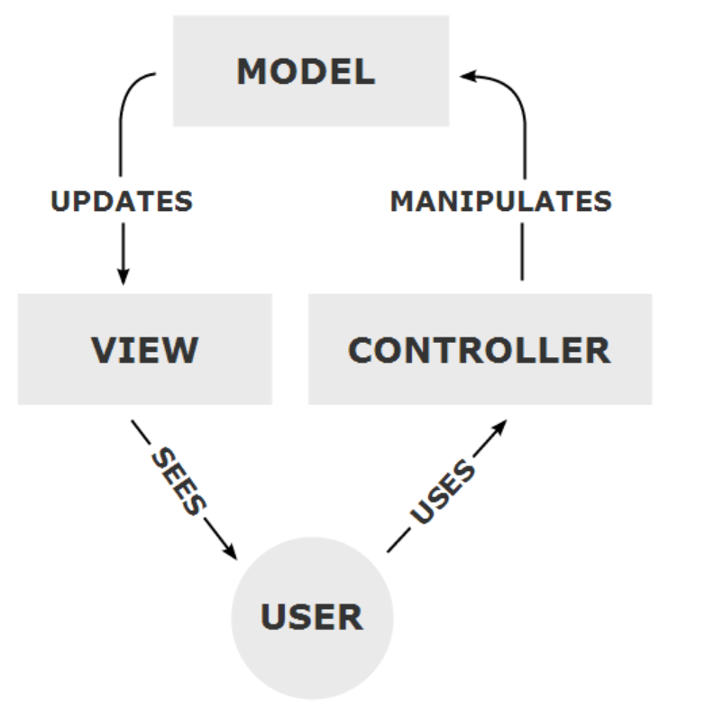
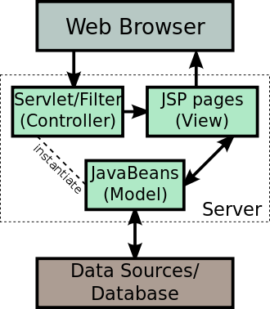
Model – View – Controller
Model – View – Controller is a common paradigm
Model = Data and application logic
View = What the user sees and interacts with
Controller = Maps between user interaction and model, or model changes and UI

Slide 14
Note
I know this is elementary.
Just want to make sure everyone has some basics in common, including terminology.
Out initial focus will be
Data
APIs
Microservices
But,
Projects and demos will require some basic UIs.
UI concepts will become more complex, especially as we add multitenancy.

Slide 15
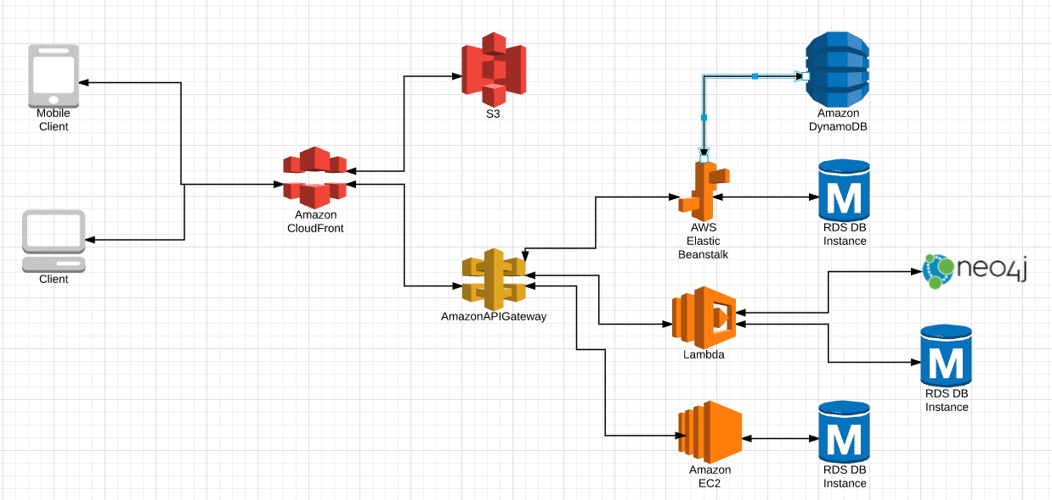
Structure of First Couple of Projects
Will not focus on native mobile apps.
Mapping between
Microservice implementations and
Databases will different/flexible, e.g Lambda – Dynamo.

Slide 16
Let’s Design an Application

Slide 17
Datamodel

Slide 18
Northwind Database (https://northwinddatabase.codeplex.com/)
Relatively simple datamodel/database that
Provides core concepts
Entity/Resource.
Relationships.
Sample data for tests and demos.
Tools and tutorials for
Importing in RDS.
Importing in DynamoDB.
etc.

Slide 19
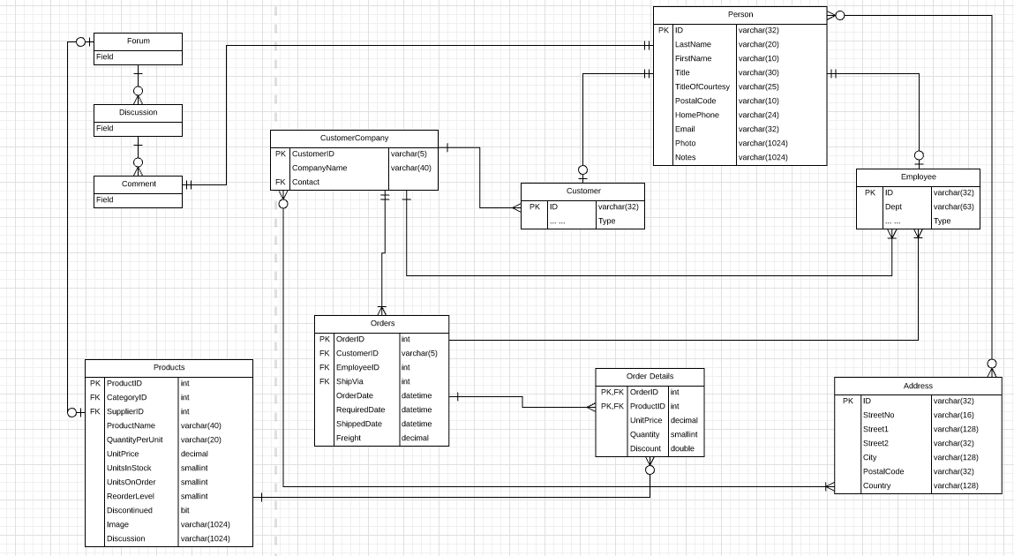
Our Modified Data Model

Slide 20
Motivation
This is not a database or database modeling course. So, why are we implementing this model? It provides a foundation for some interesting use cases:
Model of a resource with properties in a DB and links to web resources, e.g.
Photos of people and products.
Product discussion forums.
Designing a good REST API, e.g.
/orders/213/orderdetails/456/product
/orders?q=‘CustomerID=123&shipped=false’
/orders/123/OrderDetails?f=‘ProductID,Quantity’
Asynchronous methods
Integration with external cloud services, e.g. address verification, Facebook.
Handling and representing various types of data
Structured.
Unstructured.
Semi-structured.
Microservices that: extend and integrate other microservices, implement technical functions

Slide 21
User Interface

Slide 22
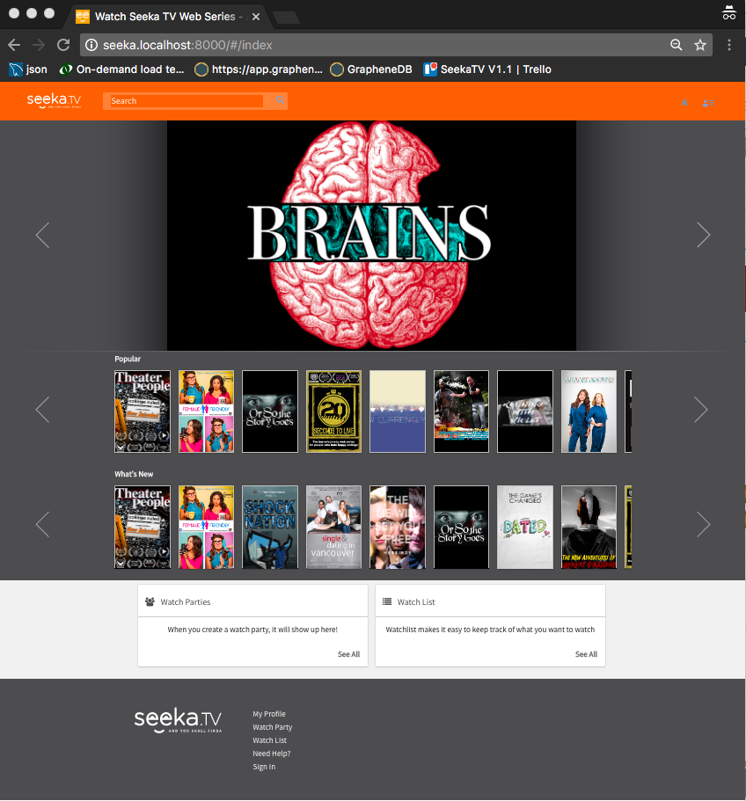
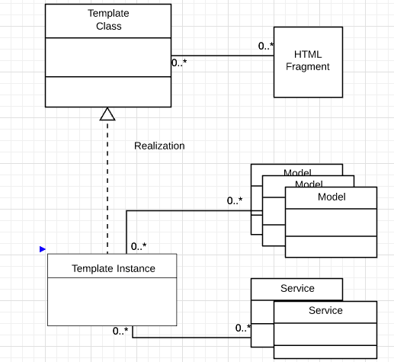
UI Conceptual Implementation

Slide 23
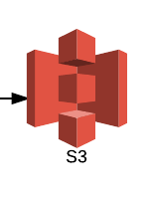
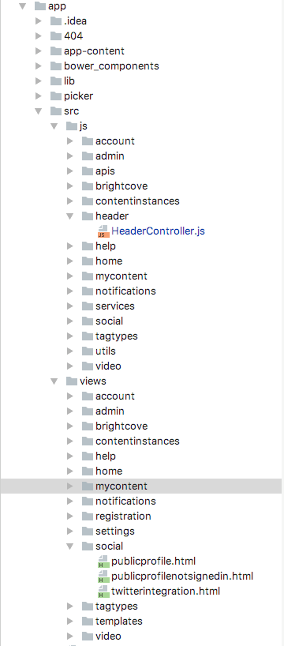
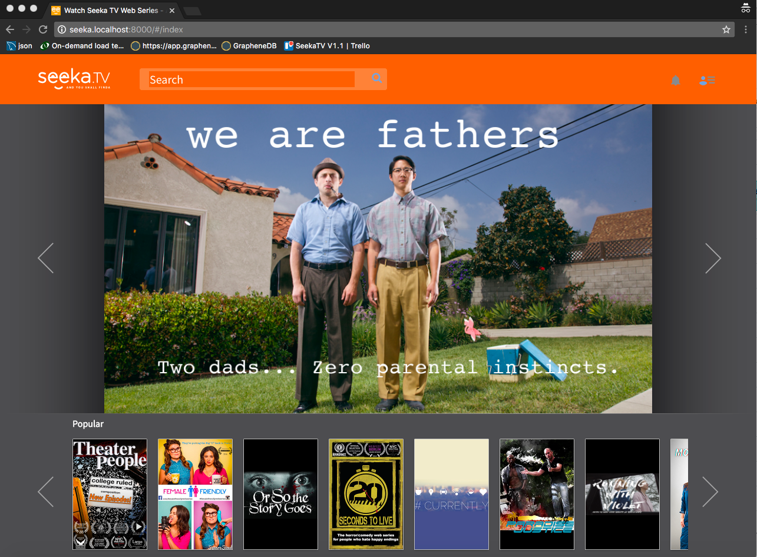
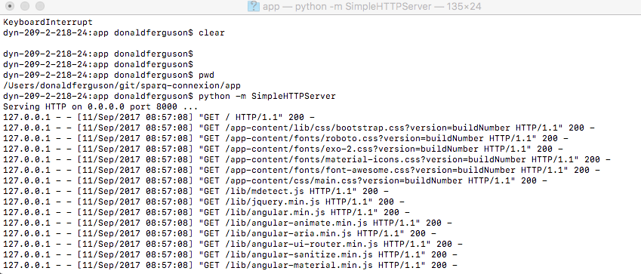
Demo Web Content Structure
Local
File
System
Local Web Server

Slide 24
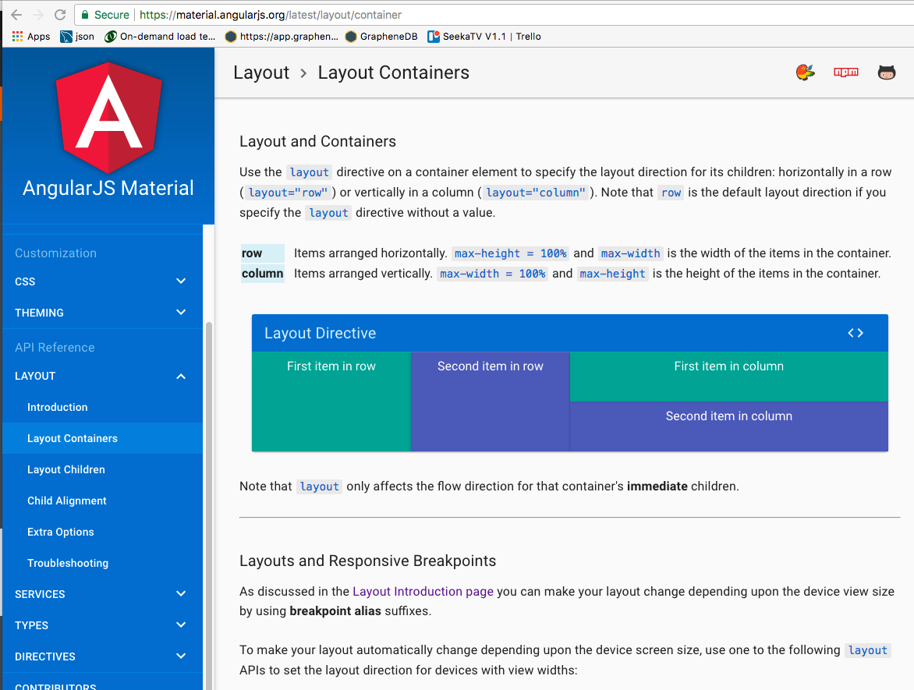
Angular JS Material (https://material.angularjs.org/)
Class examples and lectures will use Angular JS Material.
UIs will be relatively simple; this is not a UI design and implementation course.
There are equivalent and/or more modern UI tools.
Angular JS Material will become useful when we explore multitenancy.

Slide 25
Angular JS Material (https://material.angularjs.org/)
Class examples and lectures will use Angular JS Material.
UIs will be relatively simple; this is not a UI design and implementation course.
There are equivalent and/or more modern UI tools.
Angular JS Material will become useful when we explore multitenancy.
UI Implementation Guidance (for class)
Simple is good.
Objectives
Understand basic concepts.
Provide something for demos and tests.
Useful for our introduction/overview of multitenancy.

Slide 26
Microservice Model

Slide 27
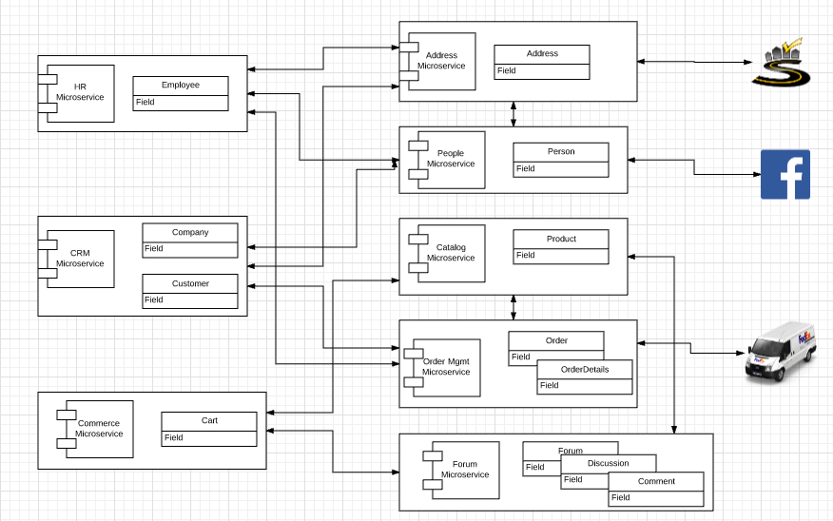
Microservice Model

Slide 28
Microservice Model
Different microservice “instances” will
Use different implementation technology, e.g. Lambda, Elastic Beanstalk
Use different databases, e.g. RDS, DynamoDB, S3, Neo4J
The categories of microservices
Base services that manage group of related resources, e.g. Product.
Services that manage a group of related resources, and integrate with external cloud applications/APIs, e.g.
Order Management → FedEx
People → Facebook
Services that aggregate, compose and orchestrate multiple services into a new, microservice, e.g
HR
CRM
Technical enabling services, e.g. text search, image management.

Slide 29
REST Model

Slide 30
Representational State Transfer (REST)
People confuse
Various forms of RPC/messaging over HTTP
With REST
REST has six core tenets
Client/server
Stateless
Caching
Uniform Interface
Layered System
Code on Demand
HATEOAS: Hypertext as the Engine of Application State --
The principle is that a client interacts with a network application entirely through hypermedia provided dynamically by application servers. A REST client needs no prior knowledge about how to interact with any particular application or server beyond a generic understanding of hypermedia.

Slide 31
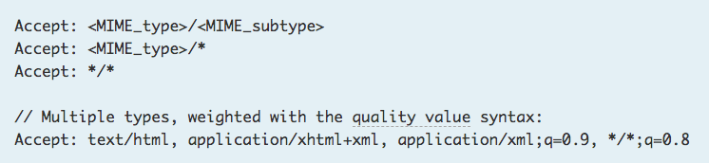
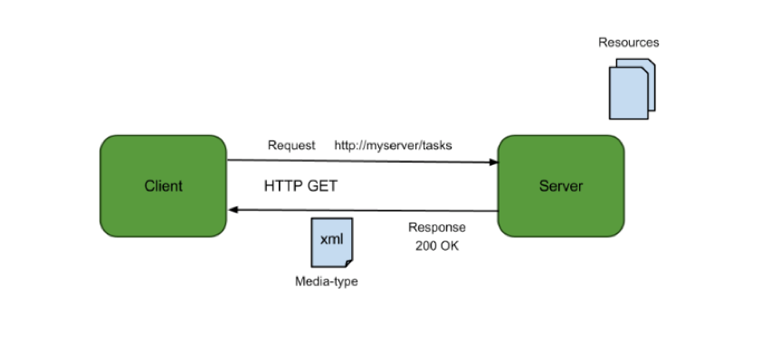
Accept type in headers.
Relative URL identifies “resource” on the server.
Server implementation maps abstract resource to tangible “thing,” file, DB row, …
Client may be
Browser
Mobile device
Microservce
… …
Web media (content) type, e.g.
text/html
application/json

Slide 32
REST Tenets
Client/Server (Obvious)
Stateless is a bit confusing
The server/service maintains resource state, e.g. Customer and Agent info.
The conversation is stateless. The client provides all conversation state needed for an API invocation. For example,
customerCursor.next(10) requires the server to remember the client’s position in the iteration through the set.
A stateless call is customerCollection.next(“Bob”, 10). Basically, the client passes the cursor position to the server.
Caching
The web has significant caching (in browser, CDNs, …)
The resource provider must
Consider caching policies in application design.
Explicitly set control fields to tell clients and intermediaries what to cache/when.

Slide 33
REST Tenets
Uniform Interface
Identify/locate resources using URIs/URLs.
A fixed set of “methods” on resources.
myResource.deposit(21.13) is not allowed.
The calls are
Get
Post
Put
Delete
Self-defining MIME types (Text, JSON, XML, …).
Default web application for using the API.
URL/URI for relationship/association.
Layered System: Client cannot tell if connected to the server or an intermediary performing value added functions, e.g.
Load balancing.
Security.
Idempotency.
Code on Demand (optional): Resource Get can deliver helper code, e.g.
JavaScript
Applets

Slide 34
Anatomy of a URL and Methods (not normative)
Collection/Set: /customers
POST: Create a new customer
GET: Return all customers, and implement
Query
Pagination
Specific Instance: /customers/dff9 (dff9 is a unique, primary key)
GET: Some or all fields.
PUT: Update some or all fields.
DELETE: Delete the specific customer.
Relationships:
Set: /customers/dff9/orders
Instance: /customers/dff9/orders/21

Slide 35
Success Response Codes
202 means
Your request went asynch.
The HTTP header Link is where to poll for rsp.
We will cover later.
Operation | HTTP Request | HTTP Response Codes Supported
READ | GET | 200 - OK with message body 204 - OK no message body 206 - OK with partial message body
CREATE | POST | 201 - Resource created (Operation Complete) 202 - Resource accepted (Operation Pending)
UPDATE | PUT | 202 - Accepted (Operation Pending) 204 - Success (Operation Complete)
DELETE | DELETE | 202 - Accepted (Operation Pending) 204 - Success (Operation Complete)
Examples of Link Headers in HTTP response:
Link: <http://api/jobs/j1>;rel=monitor;title="update profile"
Link: <http://api/reports/r1>;rel=summary;title=”access report”

Slide 36
(Some) Failure Response Code
Error | Response Code
Invalid Parameter | 400 - Invalid parameter
Authentication | 401 - Authentication failure
Permission Denied | 403 - Permission denied
Not Found | 404 - Resource not found
Invalid Request Method | 405 - Invalid request method
Unprecessable Entity | 422 – Unprocessable Entity
Internal Server Error | 500 - Internal Server Error
Service Unavailable | 503 - Service Unavailable

Slide 37
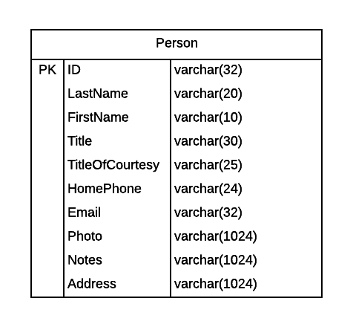
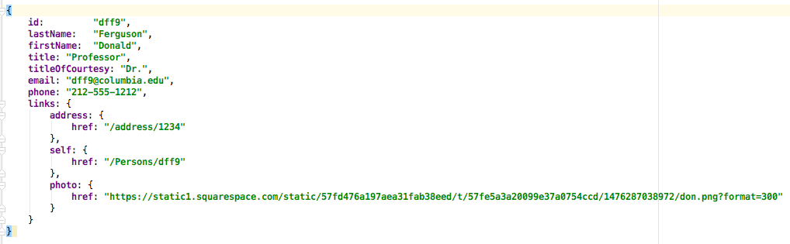
HATEOAS Response Format
Relationships
Return/Send a URL link to the related resource.
Not the piece of data that is part of the link.
Returning some of the data and a link is OK.
There is no single, agreed best practice, but most good implementations do some version of this pattern.
There are some standard link types, but not all apply. (https://www.iana.org/assignments/link-relations/link-relations.xhtml)

Slide 38
Handling Links
In a Customer
The address ID
Is actually a link
Into another set of resources
Resolving the link would require
Non-hypertext/web
Side knowledge
And violate HATEOAS
And forces some out-of-band documentation/info.
Instead, return links as links.

Slide 39
Several Patterns, for Example
Link with Resource Expansion
Simple
Data fields followed by links section.

Slide 40
Pagination/Iteration
Consider the web method GET on
/customers?lastname=Smith
/tvshows?year=2016
The result set could be thousands or millions of “records.”
The application should not/cannot return all records at once
Network/connection timeouts.
Overwhelm the client runtime with data and data processing.
Give the user a chance to realize
That they asked the “wrong question”
And submit a refined query.
etc.

Slide 41
Traditional Solution is Iterator/Cursor
GET /customers?name=bob&limit=10
… ...
... ...
GET /customers?”get next 10”
But this requires conversation state!

Slide 42
Traditional Solution is Iterator/Cursor
From “where we left off”
is “state.”
GET /customers?name=bob&limit=10
GET /customers?”get next 10”
From “where we left off …”
Requires client specific state held between requests, which violates
The REST tenet of “stateless.”
The benefits of stateless are
Not holding server resources (cursors, memory, ...) for millions of clients for several seconds/client.
Exploits the computing and storage of millions of client “computers.”
And Lambda functions are STATELESS by definition. So, you have to do it.

Slide 43
Examples
SQL
URLs
GET /customers?name=Bob&limit=10.
GET /customers?name=Bob&limit=10&offset=10
SQL
SELECT * FROM customers WHERE name=‘Bob’ LIMIT 10;
SELECT * FROM customers WHERE name=‘Bob’ LIMIT 10 OFFSET 10;
DynamoDB –
SELECT * → AttributesToGet : [ … ]
WHERE → KeyConditions: [ ... ]
LIMIT → Limit:
OFFSET → ExclusiveStartKey ==
The LastEvaluatedKey of the last record in the returned previous query result set.
Start the query at the record after the ExclusiveStartKey

Slide 44
http://docs.aws.amazon.com/amazondynamodb/latest/APIReference/API_Query.html Example
Next Request
Previous Response

Slide 45
Pagination – The response to the client has info about “where you left off” and client returns it.
{“data”: [{“user_id”:”42”, “name”:”Bob”, “links”:[{“rel”:”self”, “href”:”http://api.example.com/users/42”}]}, {“user_id”:”22”, “name”:”Frank”, “links”: [{“rel”:”self”, “href”:”http://api.example.com/users/22”}]}, {“user_id”:”125”, “name”: “Sally”, “links”:[{“rel”:”self”, “href”:”http://api.example.com/users/125”}]}],
“links”: [{“rel”:“first”, “href”:”http://api.example.com/users?offset=0&limit=3”}, {“rel”:“last”, “href”:”http://api.example.com/users?offset=55&limit=3”}, {“rel”:“previous”, “href”:”http://api.example.com/users?offset=3&limit=3”}, {“rel”:”next”, “href”:”http://api.example.com/users?offset=9&limit=3”}]}

Slide 46
Pagination – The response to the client has info about “where you left off” and client returns.
The response contains
First, Last, Previous, Next
With hrefs and URLs that are “opaque” strings.
So, the client is isolated
From the specific DB in use.
From forming database specific strings.
{“data”: [{“user_id”:”42”, “name”:”Bob”, “links”:[{“rel”:”self”, “href”:”http://api.example.com/users/42”}]}, {“user_id”:”22”, “name”:”Frank”, “links”: [{“rel”:”self”, “href”:”http://api.example.com/users/22”}]}, {“user_id”:”125”, “name”: “Sally”, “links”:[{“rel”:”self”, “href”:”http://api.example.com/users/125”}]}],
“links”: [{“rel”:“first”, “href”:”http://api.example.com/users?offset=0&limit=3”}, {“rel”:“last”, “href”:”http://api.example.com/users?offset=55&limit=3”}, {“rel”:“previous”, “href”:”http://api.example.com/users?offset=3&limit=3”}, {“rel”:”next”, “href”:”http://api.example.com/users?offset=9&limit=3”}]}

Slide 47
REST and Query
REST URLs surface two types of “query:”
Simple
/customers?lastName=Ferguson&title=Professor
Logically maps to SQL SELECT * FROM Customers WHERE lastName=‘Ferguson’ AND title=‘Professor”
But you may have to
Map DB column names to more intuitive REST property names.
Map from SQL (or other types) to valid JSON or HTML types.
Complex: Standard HTTP does not support OR, <, >=, LIKE, …
Use the q=‘’ approach: /customers?q=“lastName LIKE (Ferg) AND IQ<40”
Must map your logical language into the microservice/DB specific language.
May have to URL/Base64 encode the query string.
In either case, you have to parse and validate the string, e.g. to prevent injection attacks of the form:
/customers?lastName=Ferguson OR (1=1)

Slide 48
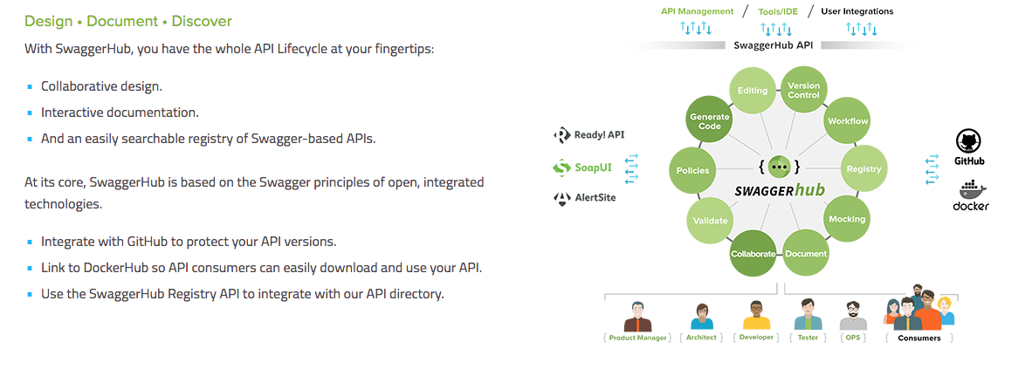
Swagger and Swagger Hub

Slide 49
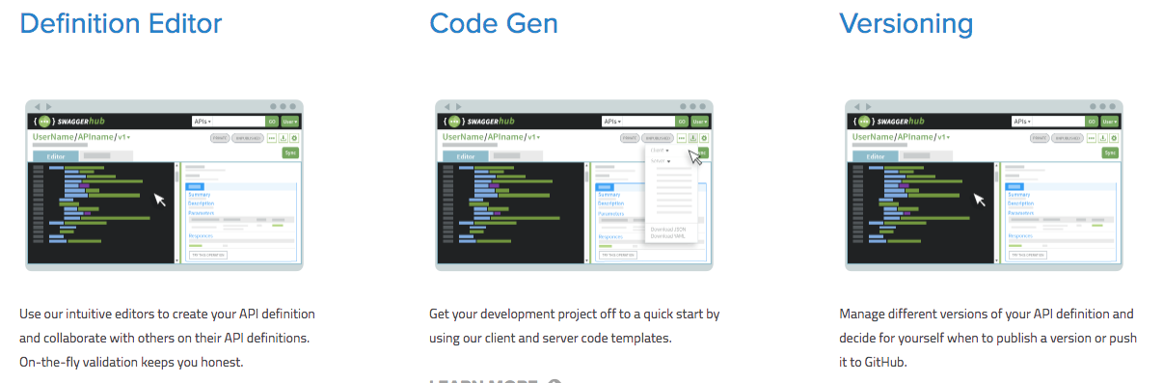
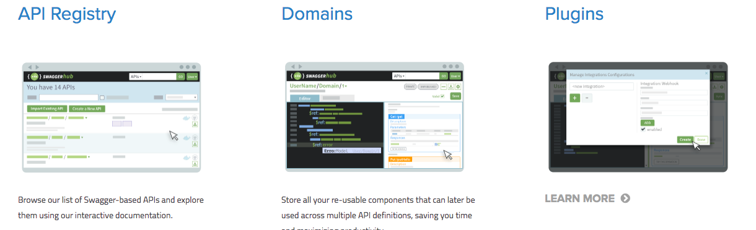

Slide 50
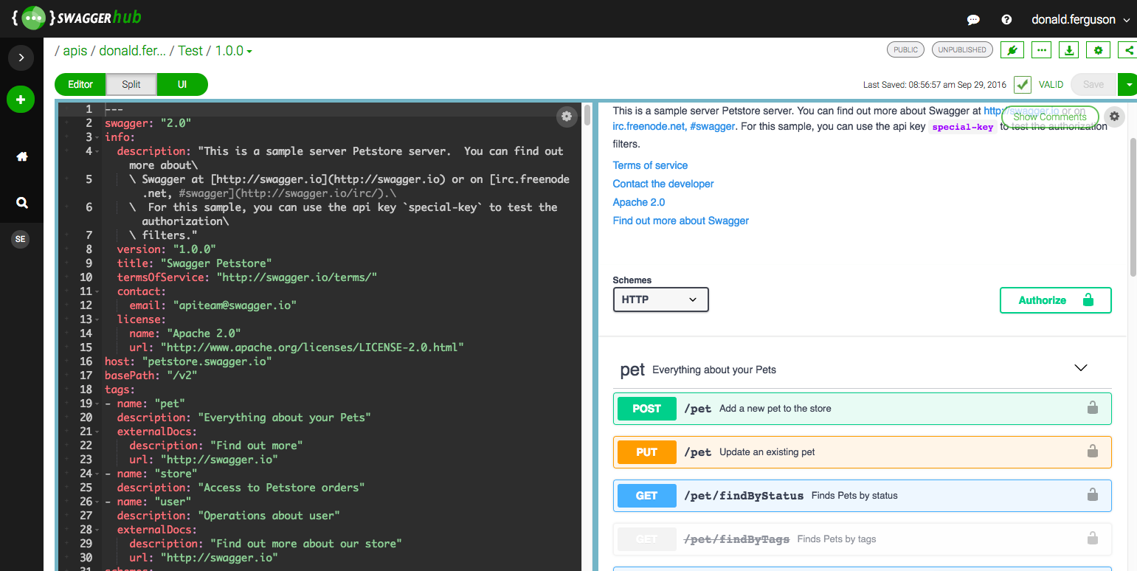
Swagger Editor

Slide 51
Swagger Editor
Demo

Slide 52
1st Project Part 1

Slide 53
1st Project – Part 1
Implement two distinct microservices
Person
Address
Tasks
Use Swagger Editor to define and document REST APIs.
Implement an Elastic Beanstalk application (microservice) for each resource that implements the relevant REST API.
Each microservice should support
GET and POST on resource, e.g. /Person
GET, PUT, DELETE on resource/id, e.g. /Person/dff9
Simple query, e.g. /Person?lastName=Ferguson
Pagination
Relationship paths: /Person/dff9/address and /Addresses/someID/persons
HATEOAS links where appropriate.
Simple HTML/Angular demo UI.
Due: 11:59 PM on 26-Sep-2017

Slide 54
1st Project – Part 1
This assignment is
Complex and a lot of work
Using technologies you have just been introduced to.
I do not expect you to get it all done or get it all correct.
We will learn iteratively based on feedback and corrections.
The IAs and I will help.
Implement two distinct microservices
Person
Address
Tasks
Use Swagger Editor to define and document REST APIs.
Implement an Elastic Beanstalk application (microservice) for each resource that implements the relevant REST API.
Each microservice should support
GET and POST on resource, e.g. /Person
GET, PUT, DELETE on resource/id, e.g. /Person/dff9
Simple query, e.g. /Person?lastName=Ferguson
Pagination
Relationship paths: /Person/dff9/address and /Addresses/someID/persons
HATEOAS links where appropriate.
Simple HTML/Angular demo UI.
Due: 11:59 PM on 26-Sep-2017

